Slide 1

Computing Algorithms Lecture 7: Decrease and Conquer part 2
By: Dr. Mohamed Moheeb

Slide 2
Agenda
Generating permutation
Generating subsets
Binary search
Russian peasant multiplication
Josephus problem

Slide 3

Generating Permutation

Slide 4
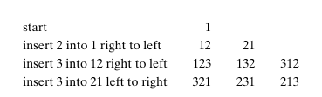
Minimal-change Requirement
Let’s make a permutation of 3 using this algorithm
It starts with the first element and then swaps the next element from left to right or right to left till the whole permutation is created.

Slide 5
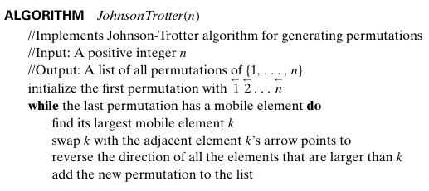


Johnson Trotter

Slide 6
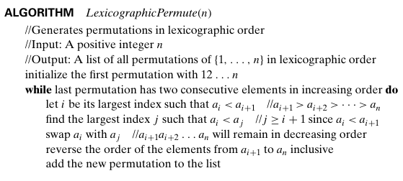
Lexicographic permutation
123 132
213 231
312 321

Slide 7
Permutation
Permutation problem is an expensive problem, as explained before, it costs O(n!) To create the permutation of size n
By using the decrease and conquer, this cost can be reduced; it will still be O(n!), but the actual execution time is lower because the algorithm generates each new permutation using a single swap rather than rebuilding the entire sequence.

Slide 8
Generating Subset

Slide 9
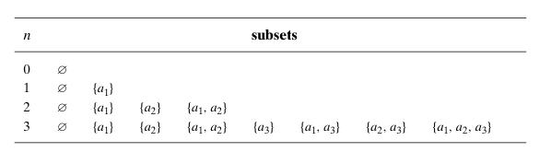
Bottum-up algorithm
It starts with an empty set and one by one adds a new element to all the generated subsets until this point.

Slide 10
Binary Representation
This is the simplest way to create a list of binary numbers till the value n
Then you replace the occurrence of the value of 1 by the equivalent element

Slide 11
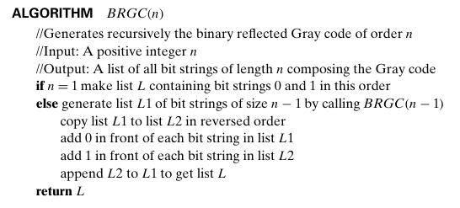

Binary Reflect Gray code

Slide 12
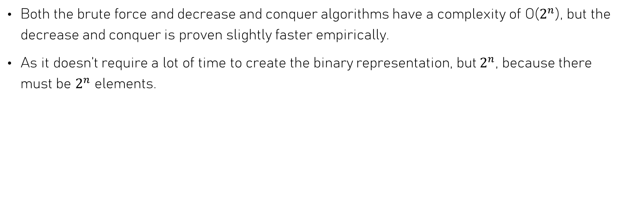
Generating subset
Both the brute force and decrease and conquer algorithms have a complexity of O($2^{n}$), but the decrease and conquer is proven slightly faster empirically.
As it doesn’t require a lot of time to create the binary representation, but $2^{n}$, because there must be $2^{n}$ elements.

Slide 13
Binary Search

Slide 14
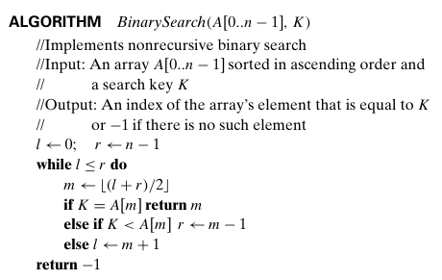
Binary search

Slide 15

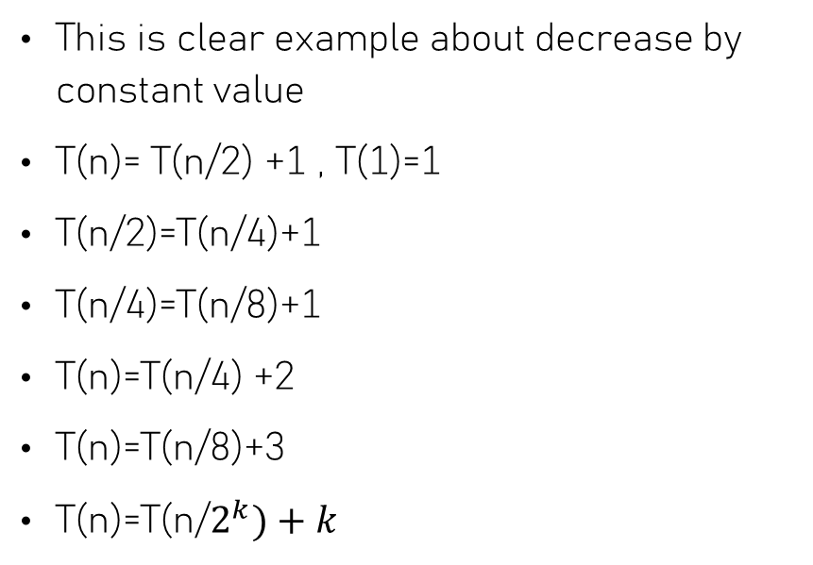

Binary Search
This is clear example about decrease by constant value
T(n)= T(n/2) +1 , T(1)=1
T(n/2)=T(n/4)+1
T(n/4)=T(n/8)+1
T(n)=T(n/4) +2
T(n)=T(n/8)+3
T(n)=T(n/$2^{k})+k$
n/$2^{k}=1$
$2^{k}=n$
$k=\log_{2}{n}$
T(n)= T(1)+ $\log_{2}{n}$= 1+ $\log_{2}{n}$
$$θ(\log_{2}{n)}$$

Slide 16
Russian peasant Multiplication

Slide 17
Russian peasant Multiplication
Algorithm for multiplying two positive integers called multiplication `a la russe or the Russian peasant method. Which is also divided by a constant factor
Let n and m be positive integers whose product we want to compute, and let us measure the instance size by the value of n.
if n is even, an instance of half the size has to deal with n/2
we have an obvious formula relating the solution to the problem’s larger instance to the solution to the smaller one (n . m = n/2 . 2m)
For odd numbers (n . m= n−1/ 2 . 2m +m).

Slide 18
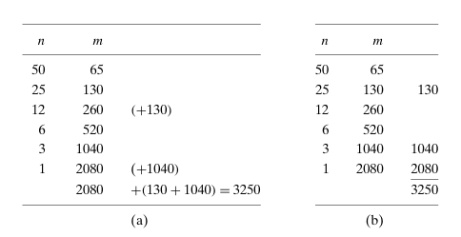

Russian peasant Multiplication
This algorithm works in the same manner as the binary search, which makes it have the same time complexity
$$θ(\log_{2}{n)}$$

